Slide 1


Indoor Spatial Awareness 2016
October 31, 2016
Ubiquitous Real-time Geo-Spatial Localization
Ashish Gupta
Alper Yilmaz

Slide 2
Outline
Motivation & Design Philosophy
Input
GIS, BIM
Sensor Trajectory
Methodology
Results
Discussion & Future Work

Slide 3
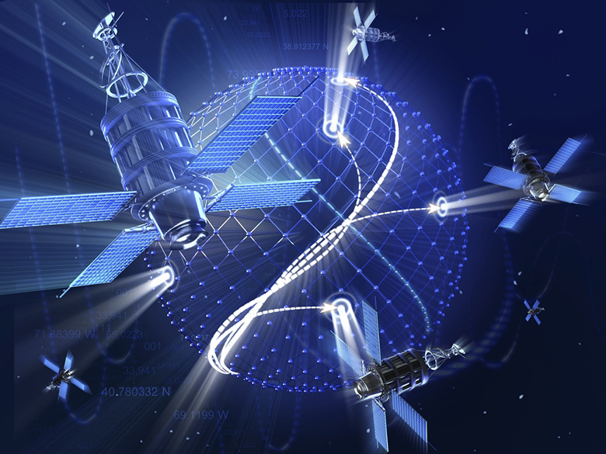
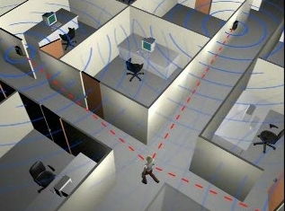
Toward Ubiquitous Localization
Outdoors
GNSS: GPS, GLONASS, Galileo
Indoors
IPS: RFID, WiFi, UWB

Slide 4
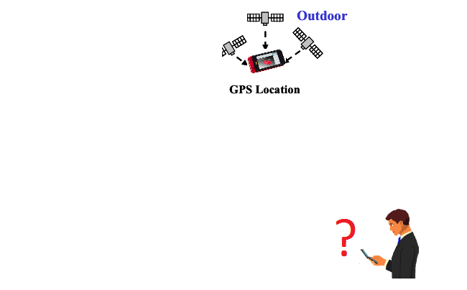
Outdoor: GPS

Slide 5
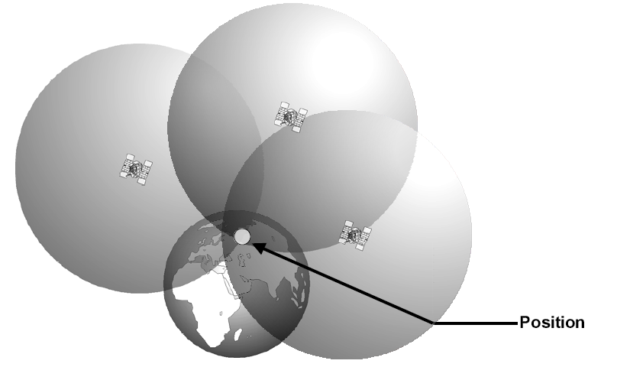
GPS … Triangulation

Slide 6
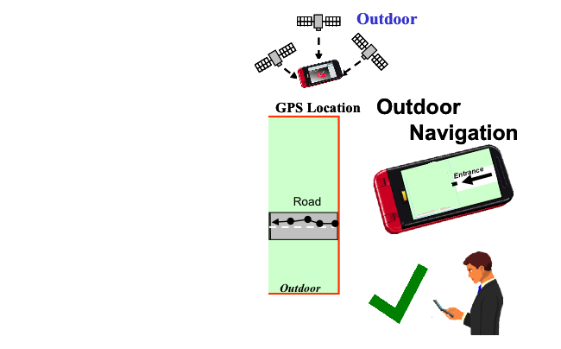
GPS -> Position (lat, long)

Slide 7
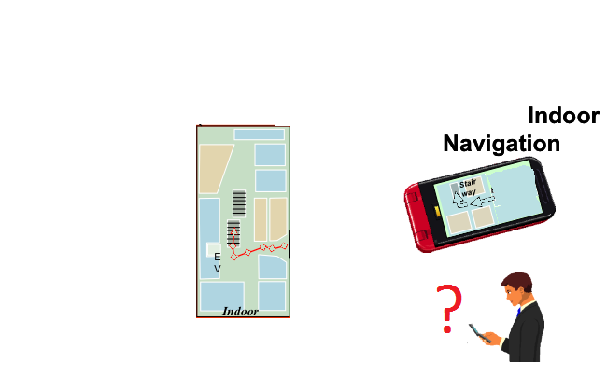
Indoor -> No GPS!

Slide 8
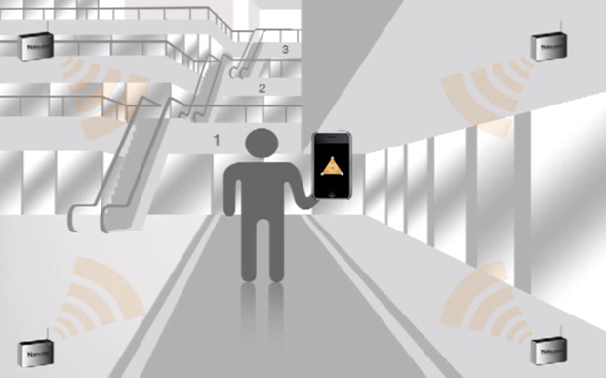
Indoor Positioning System

Slide 9
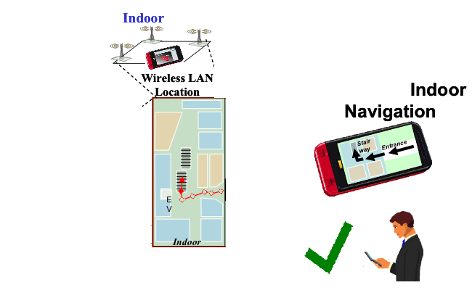
Indoor: IPS

Slide 10
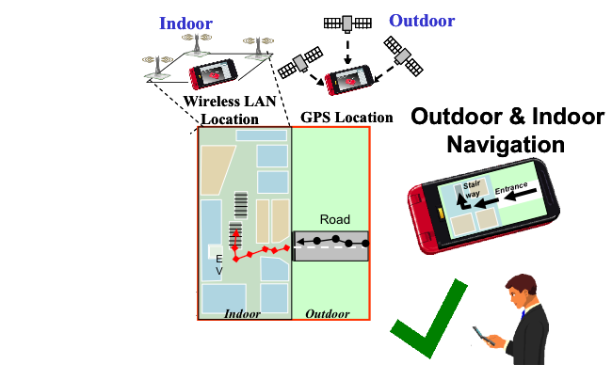
Outdoor & Indoor : GPS + IPS

Slide 11
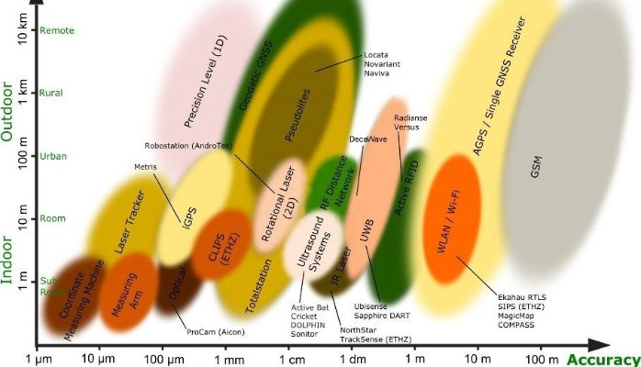
Technologies

Slide 12
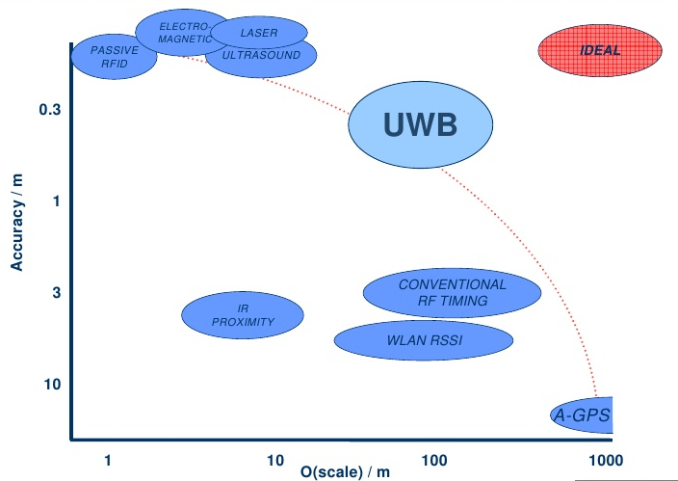
Scale & Accuracy

Slide 13
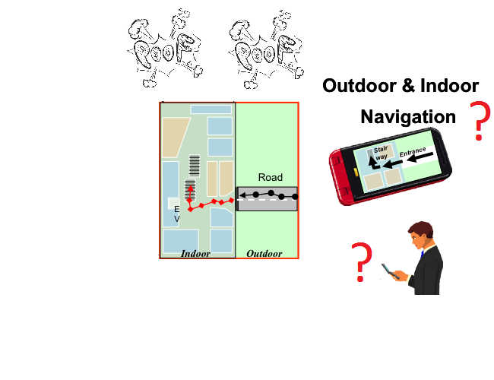
No GPS, No IPS !!!
Satellite signals unavailable
Wireless transmitters uninstalled

Slide 14
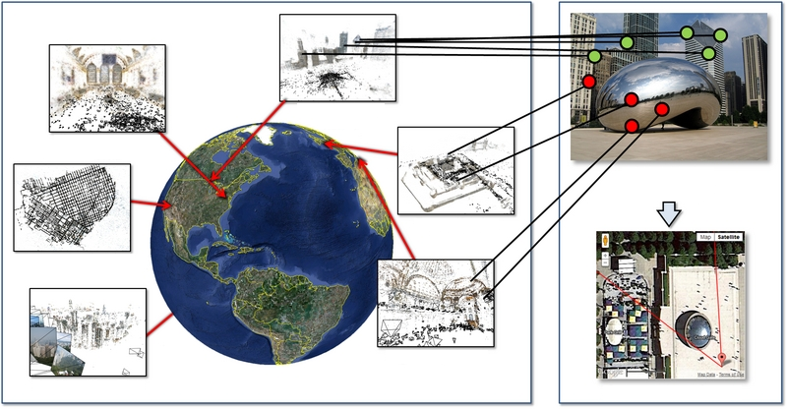
Alternate S.O.T.A.: Image Retrieval
Recognize geo-tagged landmarks in an image to infer geo-location of query image.

Slide 15


Issues with geo-tagged retreival
Computational complexity
Communication requirement
Spatial scalability
Lacking Topology
15
Notes:
Cbir reqiures high comm bandwidth

Slide 16
Our Design Objectives:
Resource efficient processing
Mobile platforms
No data communication
Standalone mode
Offline GIS
Independent of spatial priors
Indoor/outdoor, urban/rural, county/country, etc.
Independent of map sparsity
Relies on map topology
Capable of exploiting GIS layers
Transport, hydrology, relief, etc.

Slide 17



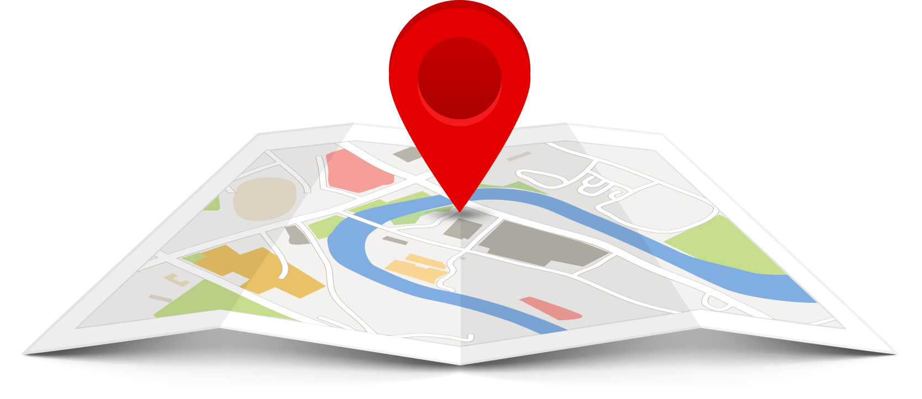
Localization → ← Navigation
&
Real-time Geo-Navigation
Dynamic Location Awareness
Static Location Information

Slide 18


Position & Motion
If you know where you are, you can decide where you are going.
If you know where you are going, you can determine where you are

Slide 19
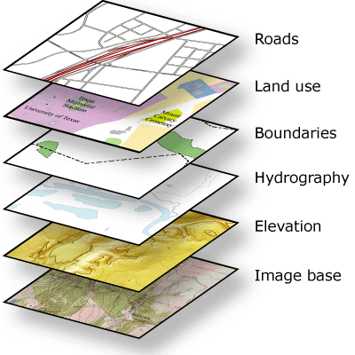
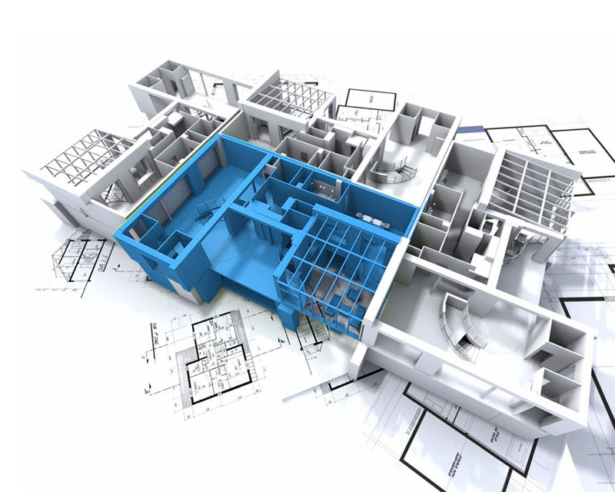
Dynamic Location Awareness
Navigation
GPS
GPS-Degraded
Alternate Sensors
Visual
IMU
Static Location Information
Geographic Information System
Building Information Model
Notes:
Relative position. Mobile platform refers to hand held camera on automobile, UAV, boats

Slide 20
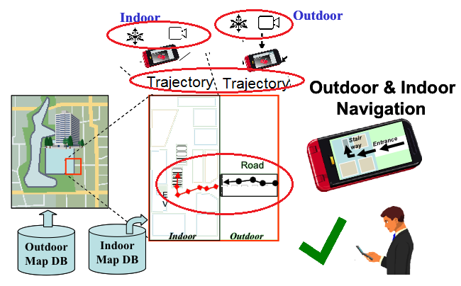
Sensor based trajectory estimation

Slide 21
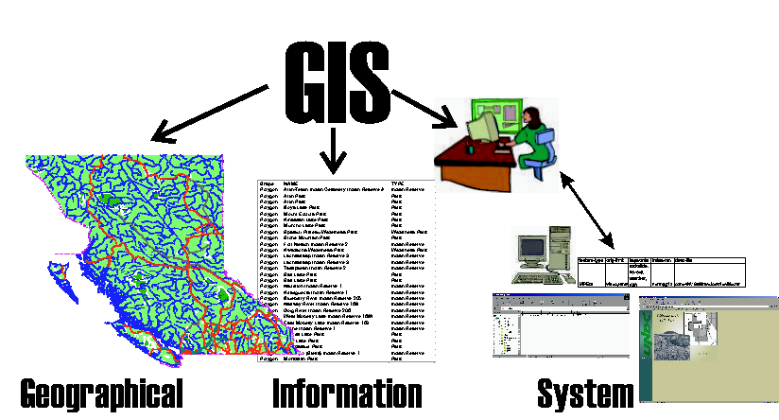
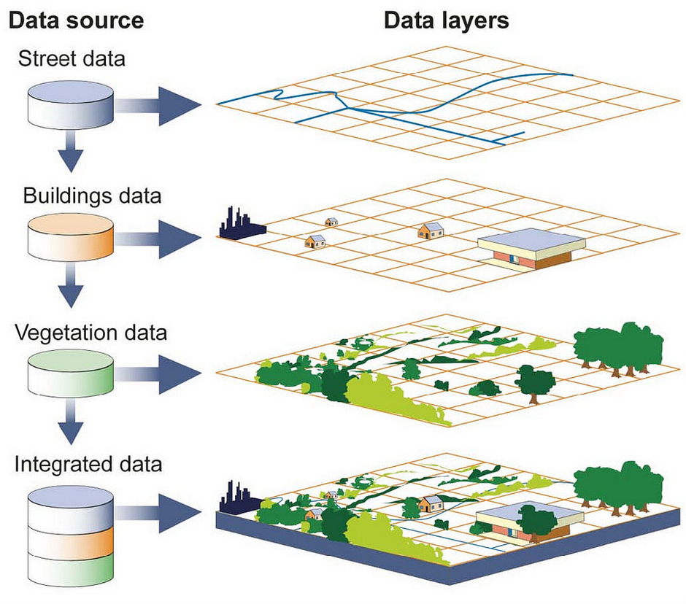
GIS is continuously growing geo-information repository
Different layers provide complementary feature topology
Geo-info in separate layers that can be integrated
Notes:
Current focus on ‘road network’ layer using public domain databases like ‘Open Street Map’

Slide 22
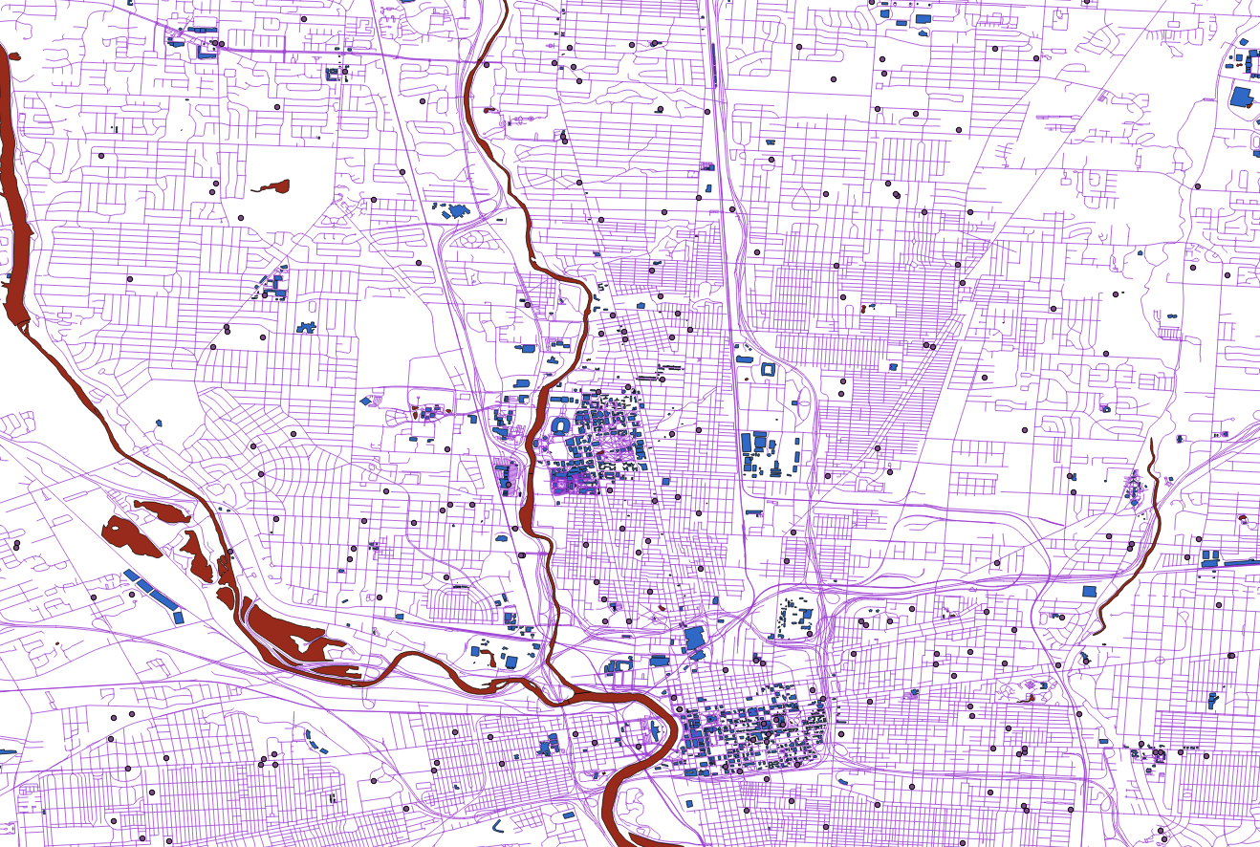
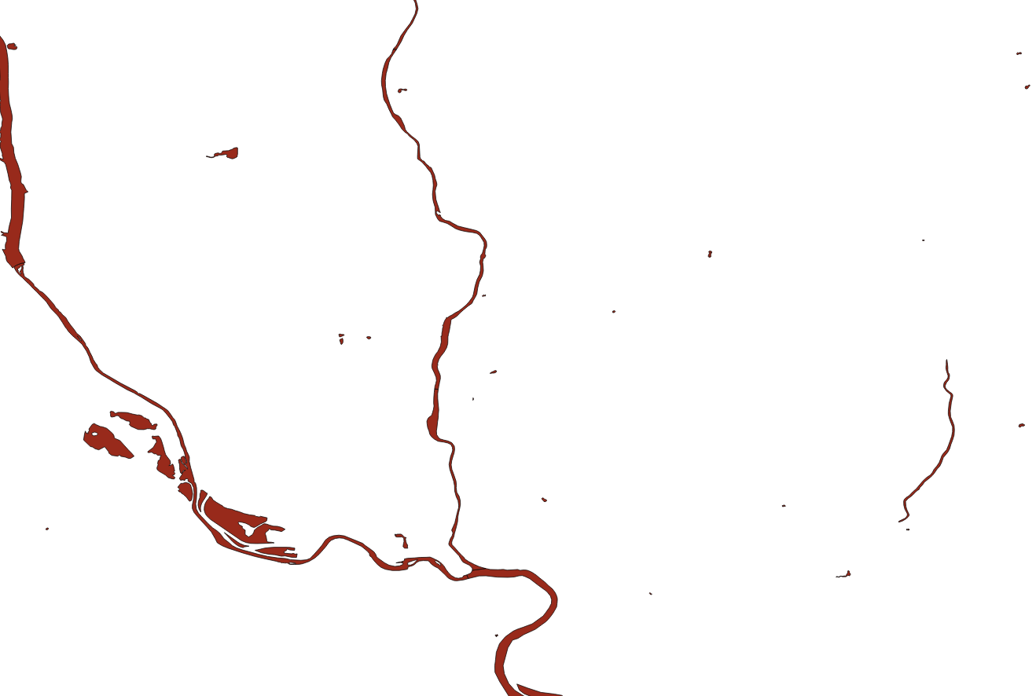

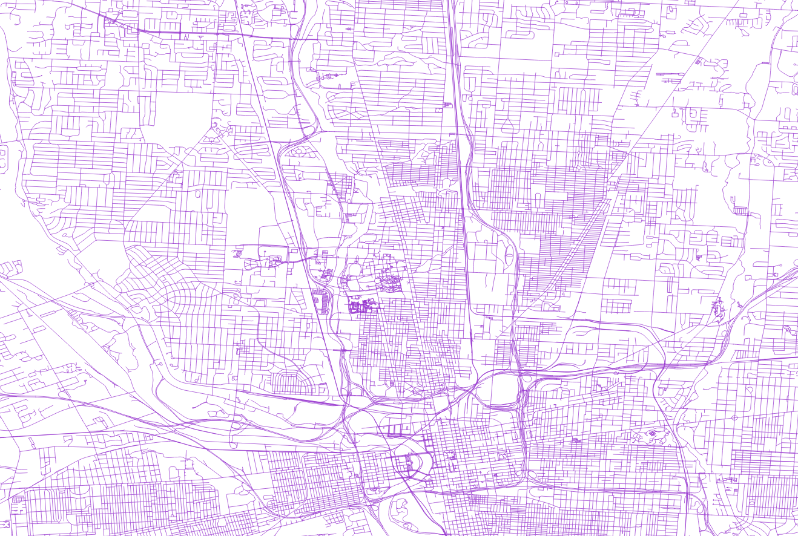
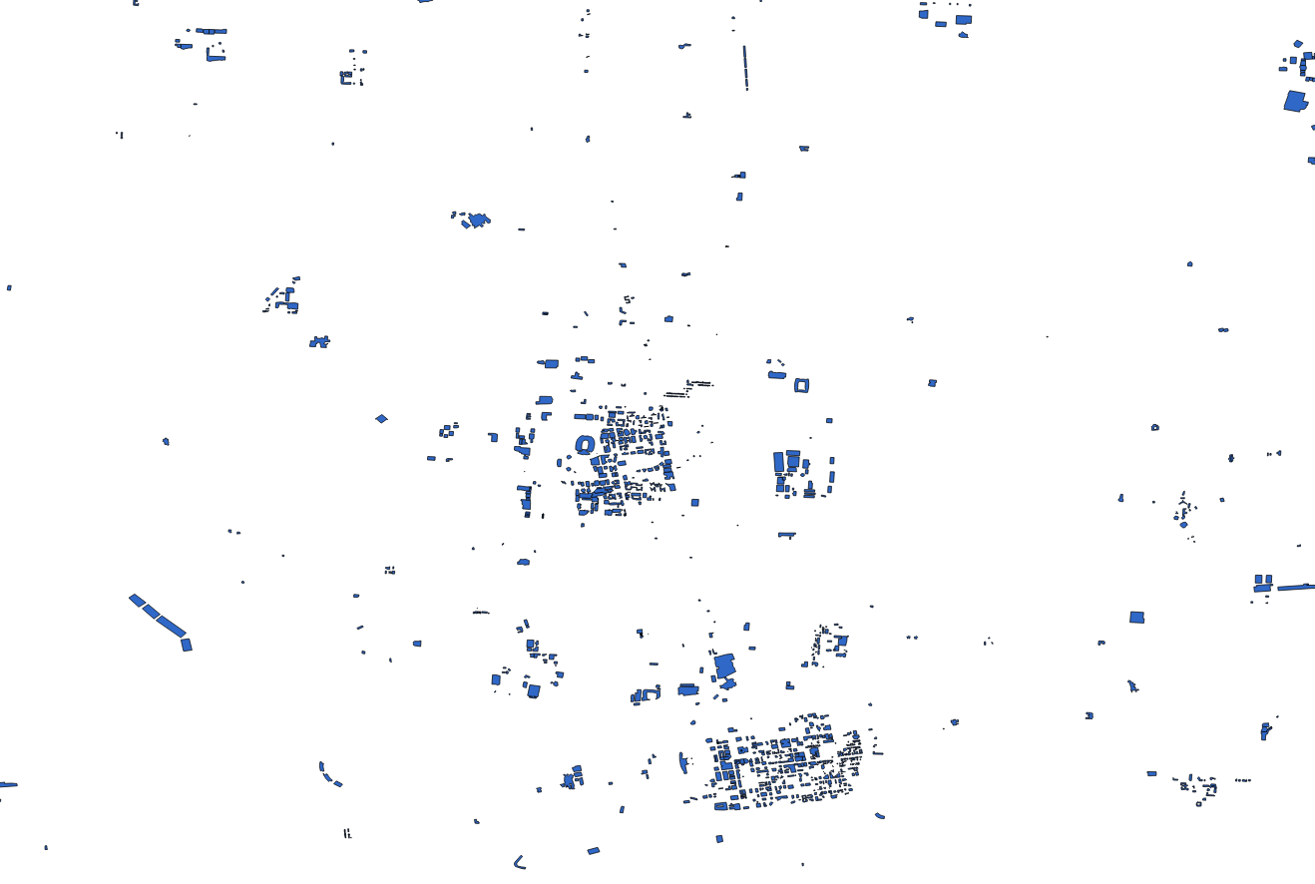
GIS Layers in Columbus, OH
waterways
amenities
roads
buildings

Slide 23
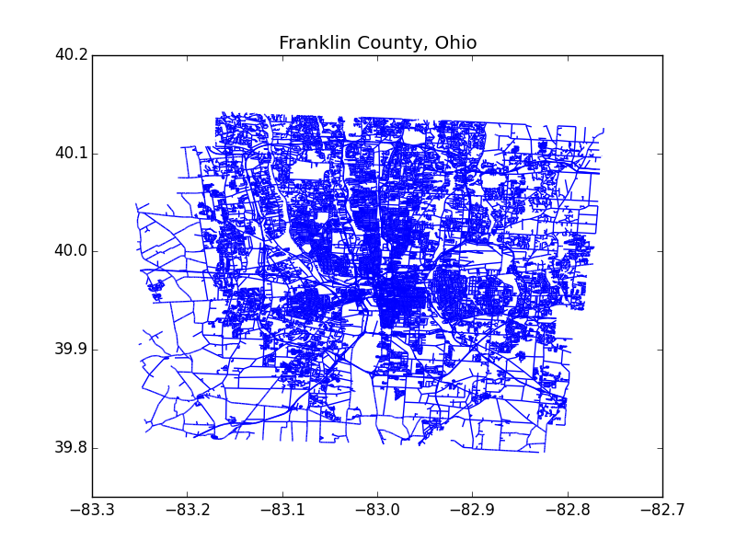
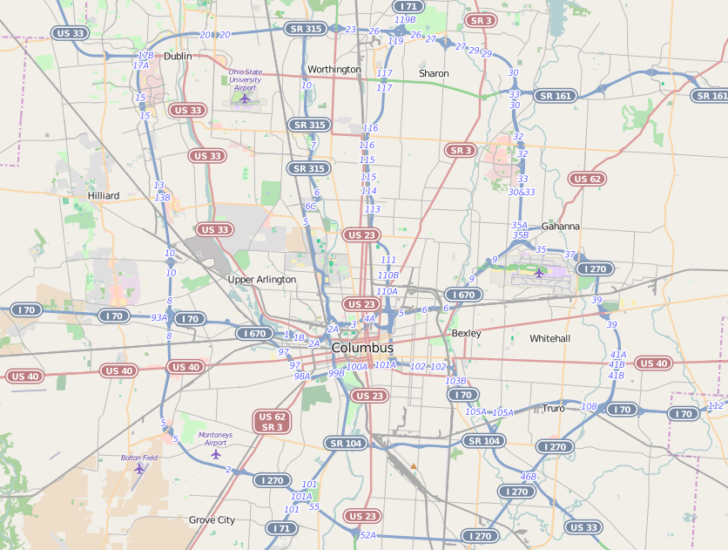
GIS abstraction
Map → Graph
Data is noisy: registration, position
Missing data: connectivity, intersections
Automated map preprocessing and restoration

Slide 24
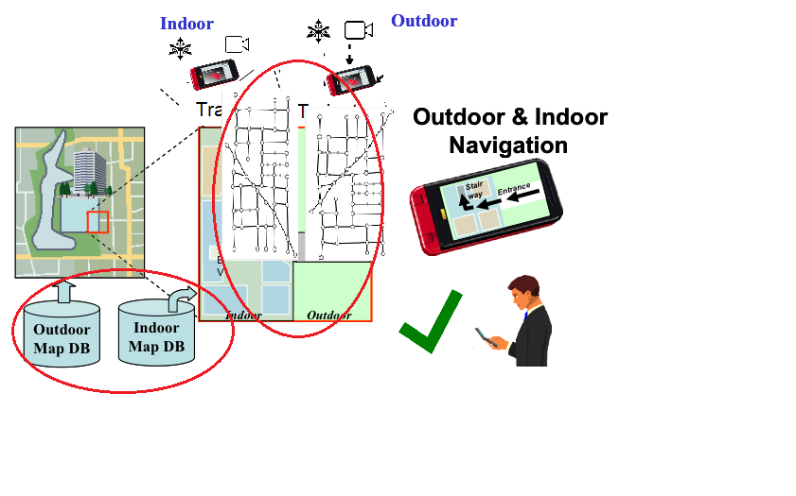
Graph Database of Indoor & Outdoor

Slide 25
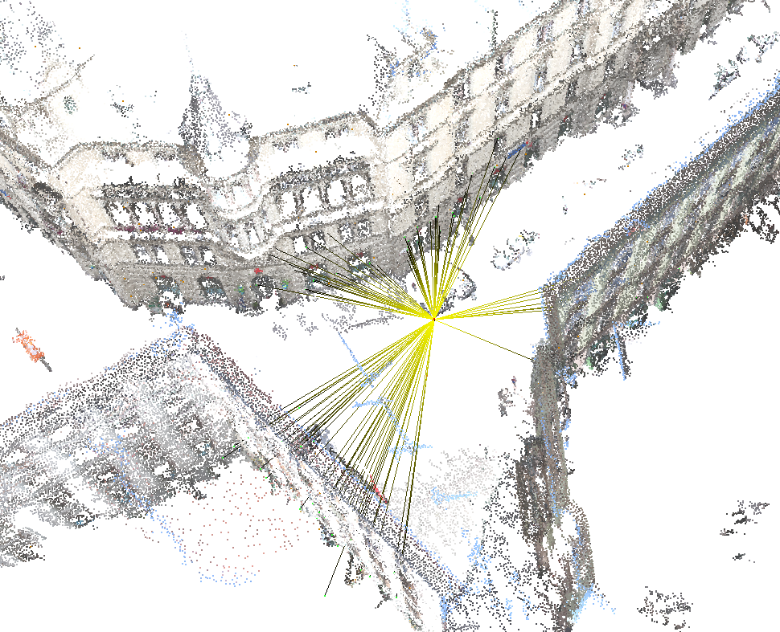
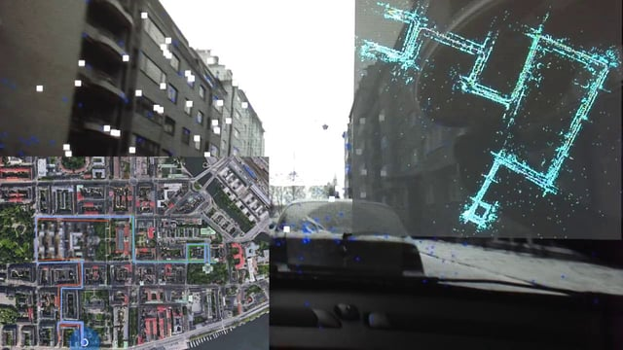
Sensor Trajectory
Triangulation
Ultra Wide Band
Visual Odometry
Sonar
Inertial measurements

Slide 26
Methodology
IMU data
Camera frames
IMU and Camera Calibration
Data Synchronization
Feature tracking
Initial State
Noise and Filter Parameters
State and covariance propagation
Triangulation
Kalman filter
Camera pose

Slide 27
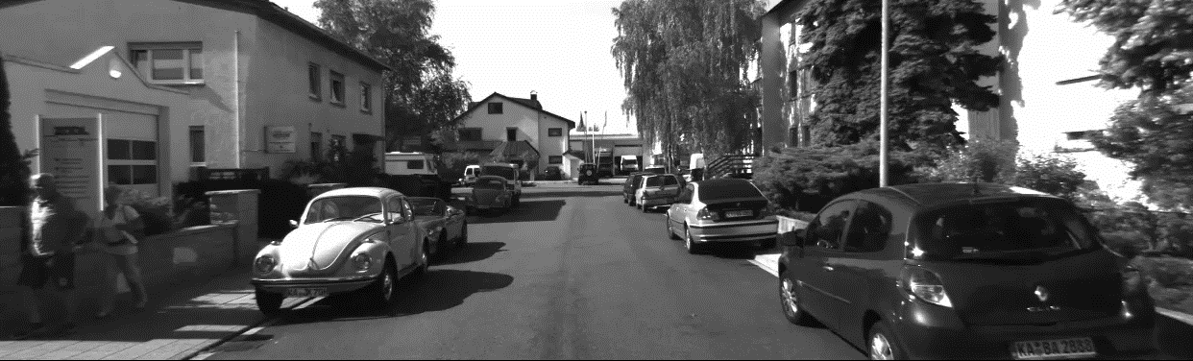
Visual Sensor data

Slide 28
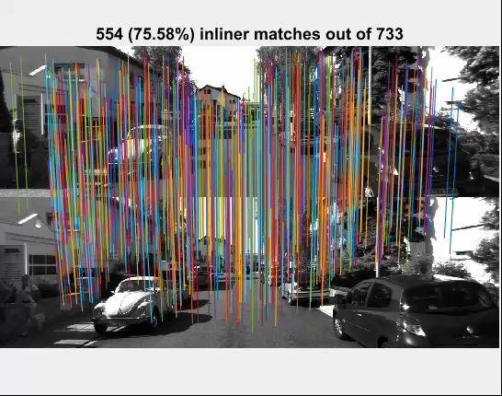
Matching across video frames

Slide 29
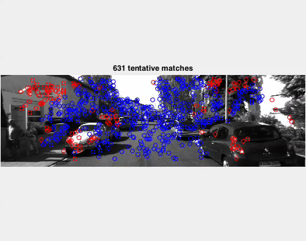
Geometric Inlier Outlier Sets

Slide 30
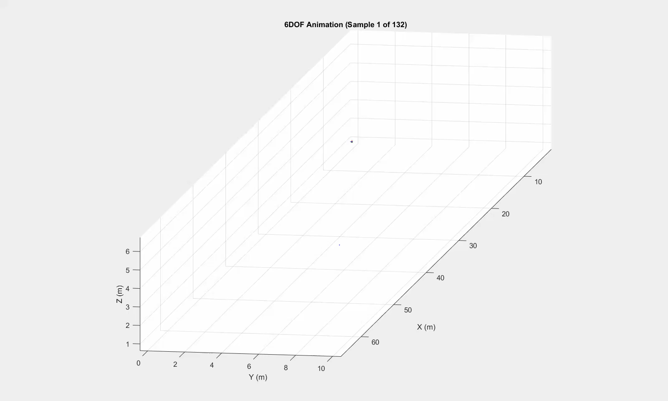
Trajectory of sensor from keypoints

Slide 31
Evaluation of 3D trajectory

Slide 32
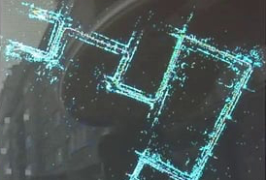
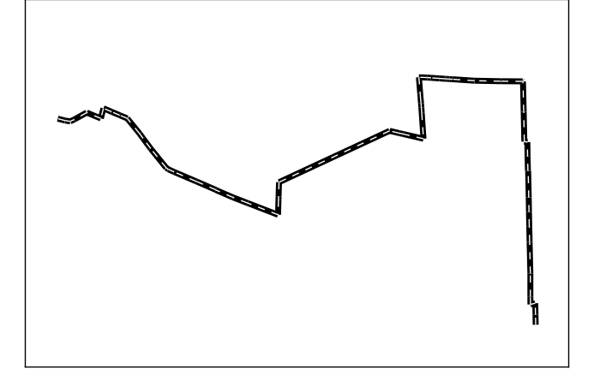
Search Trajectory

Slide 33
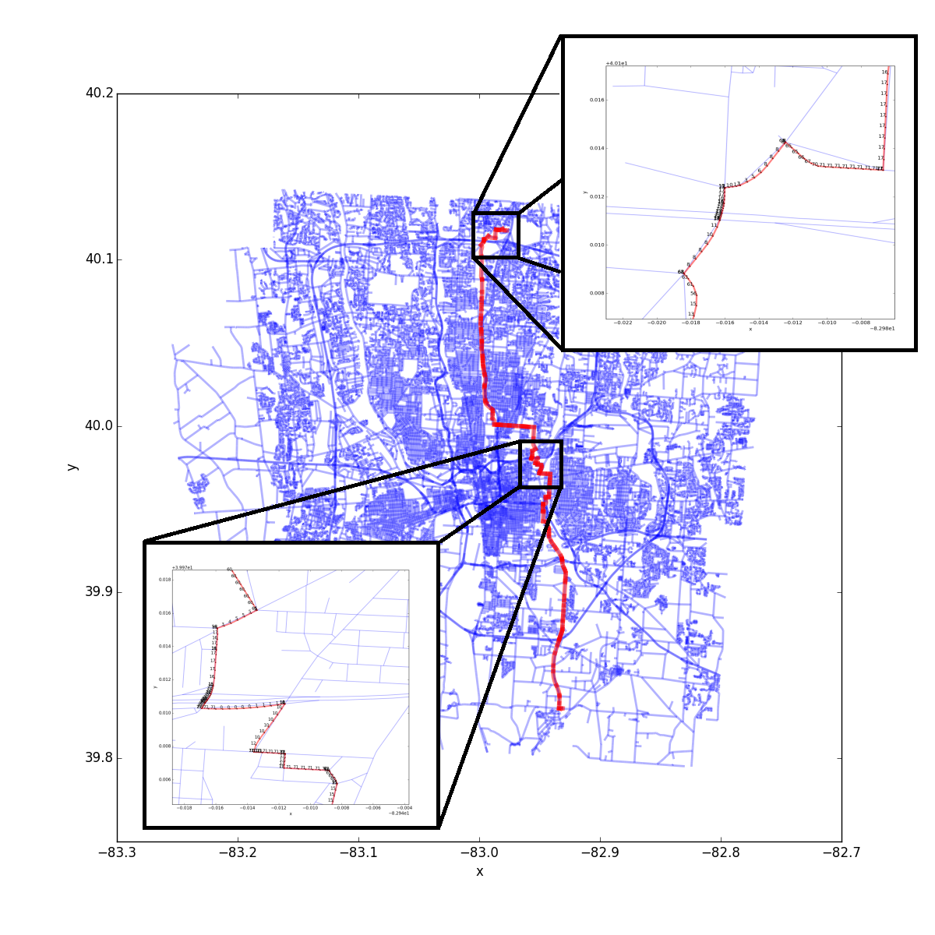
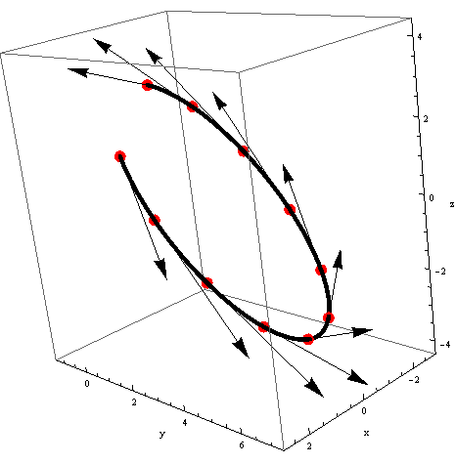
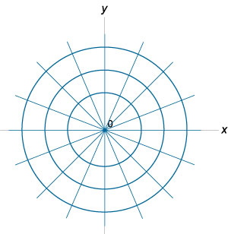
Encoding Trajectories
Graph-edges (Road) descriptors along a trajectory
Encode trajectory in quantized polar coordinates

Slide 34
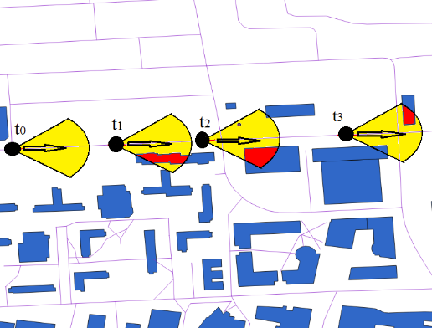
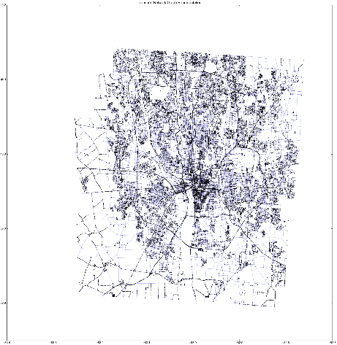
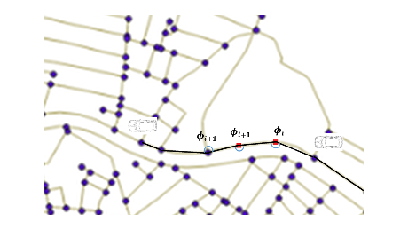
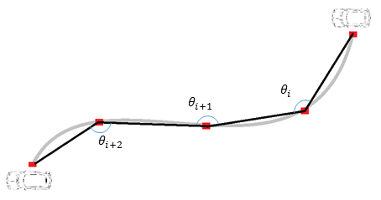
Platform Trajectory
Graph Traversal

Slide 35
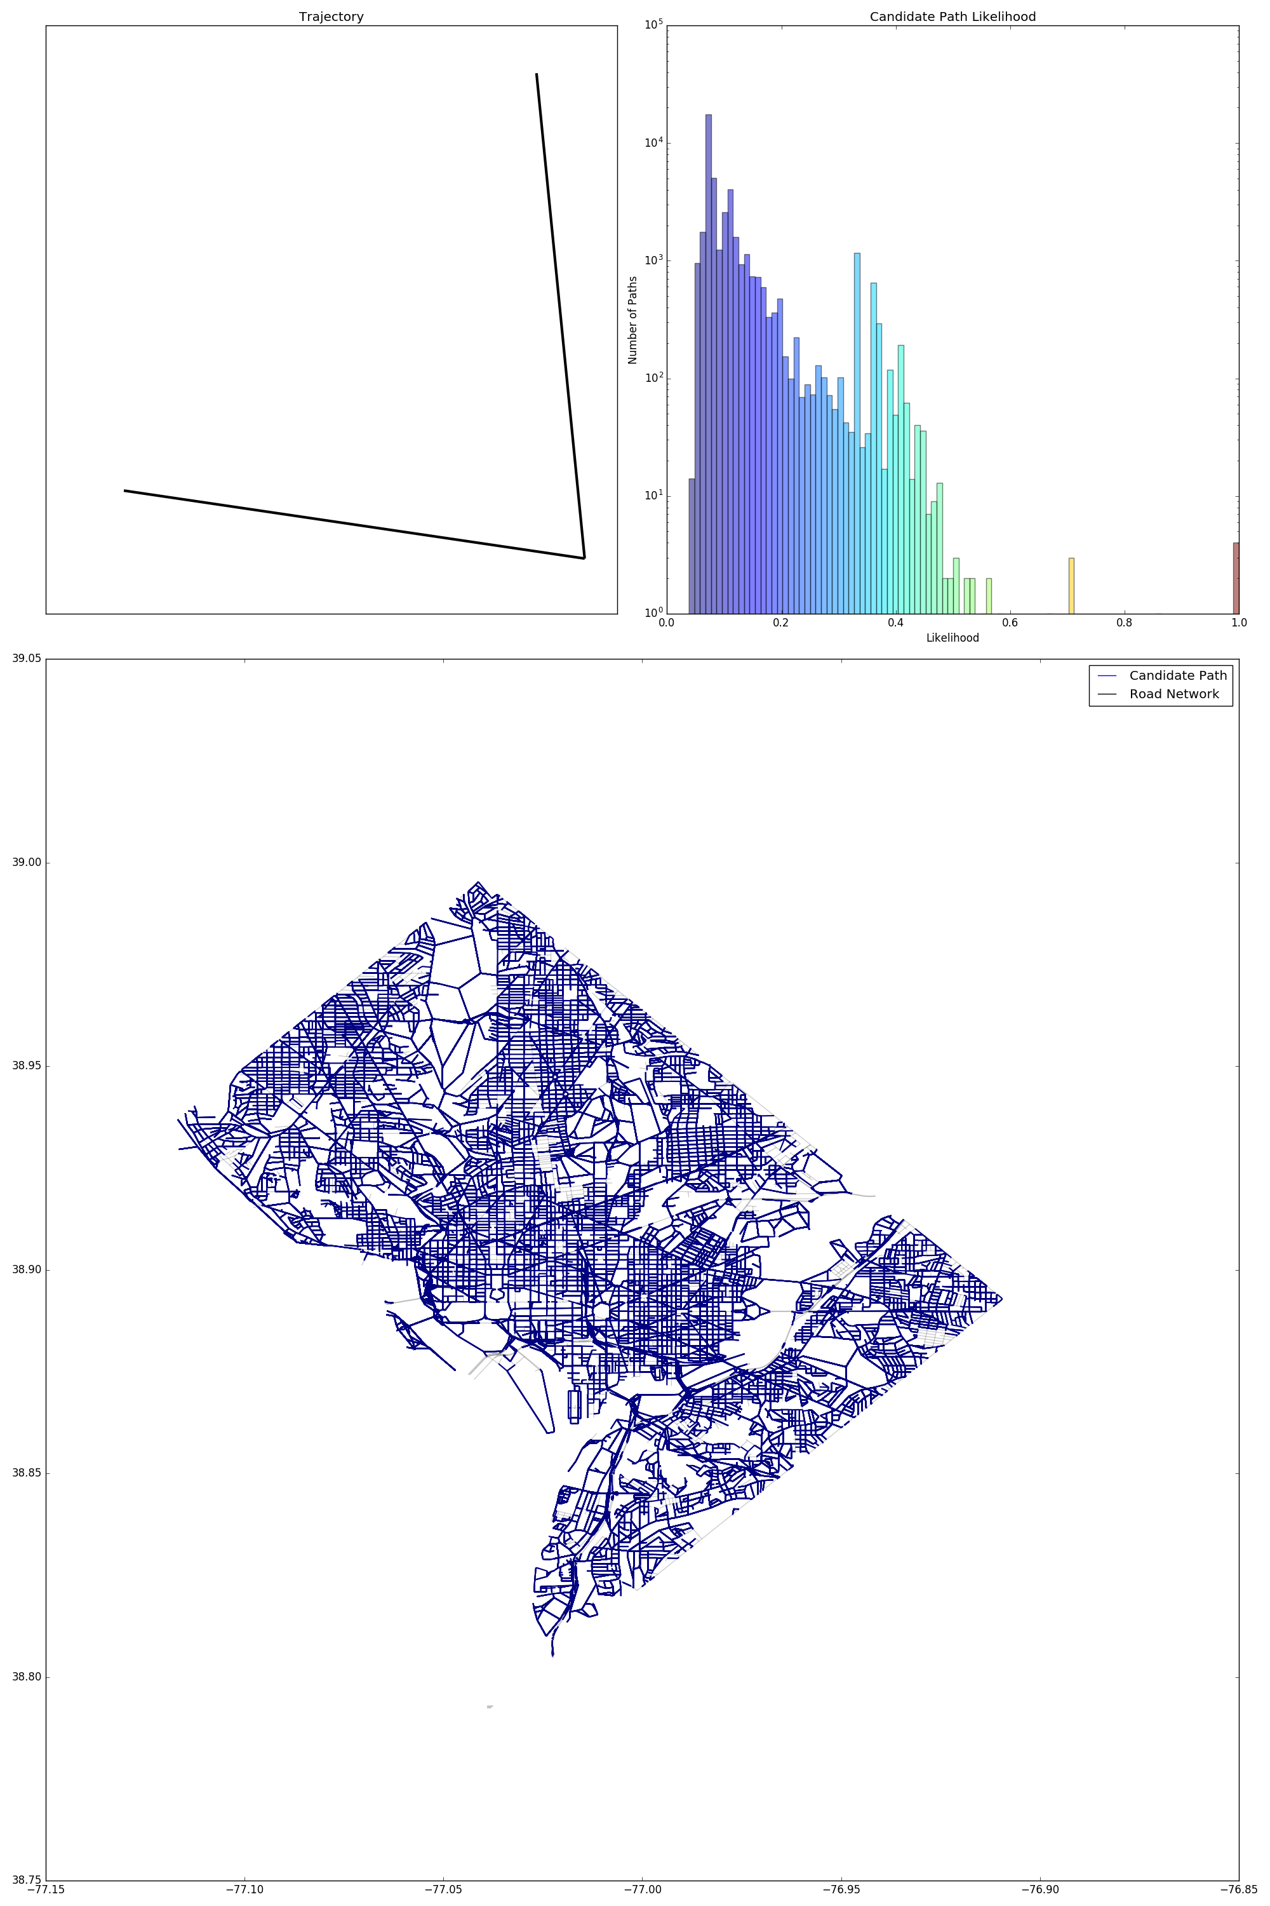
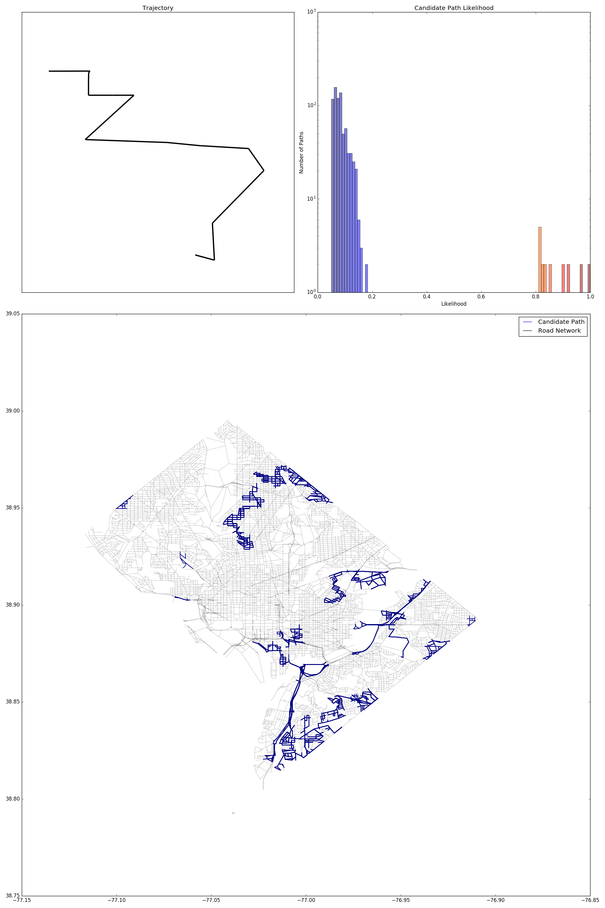
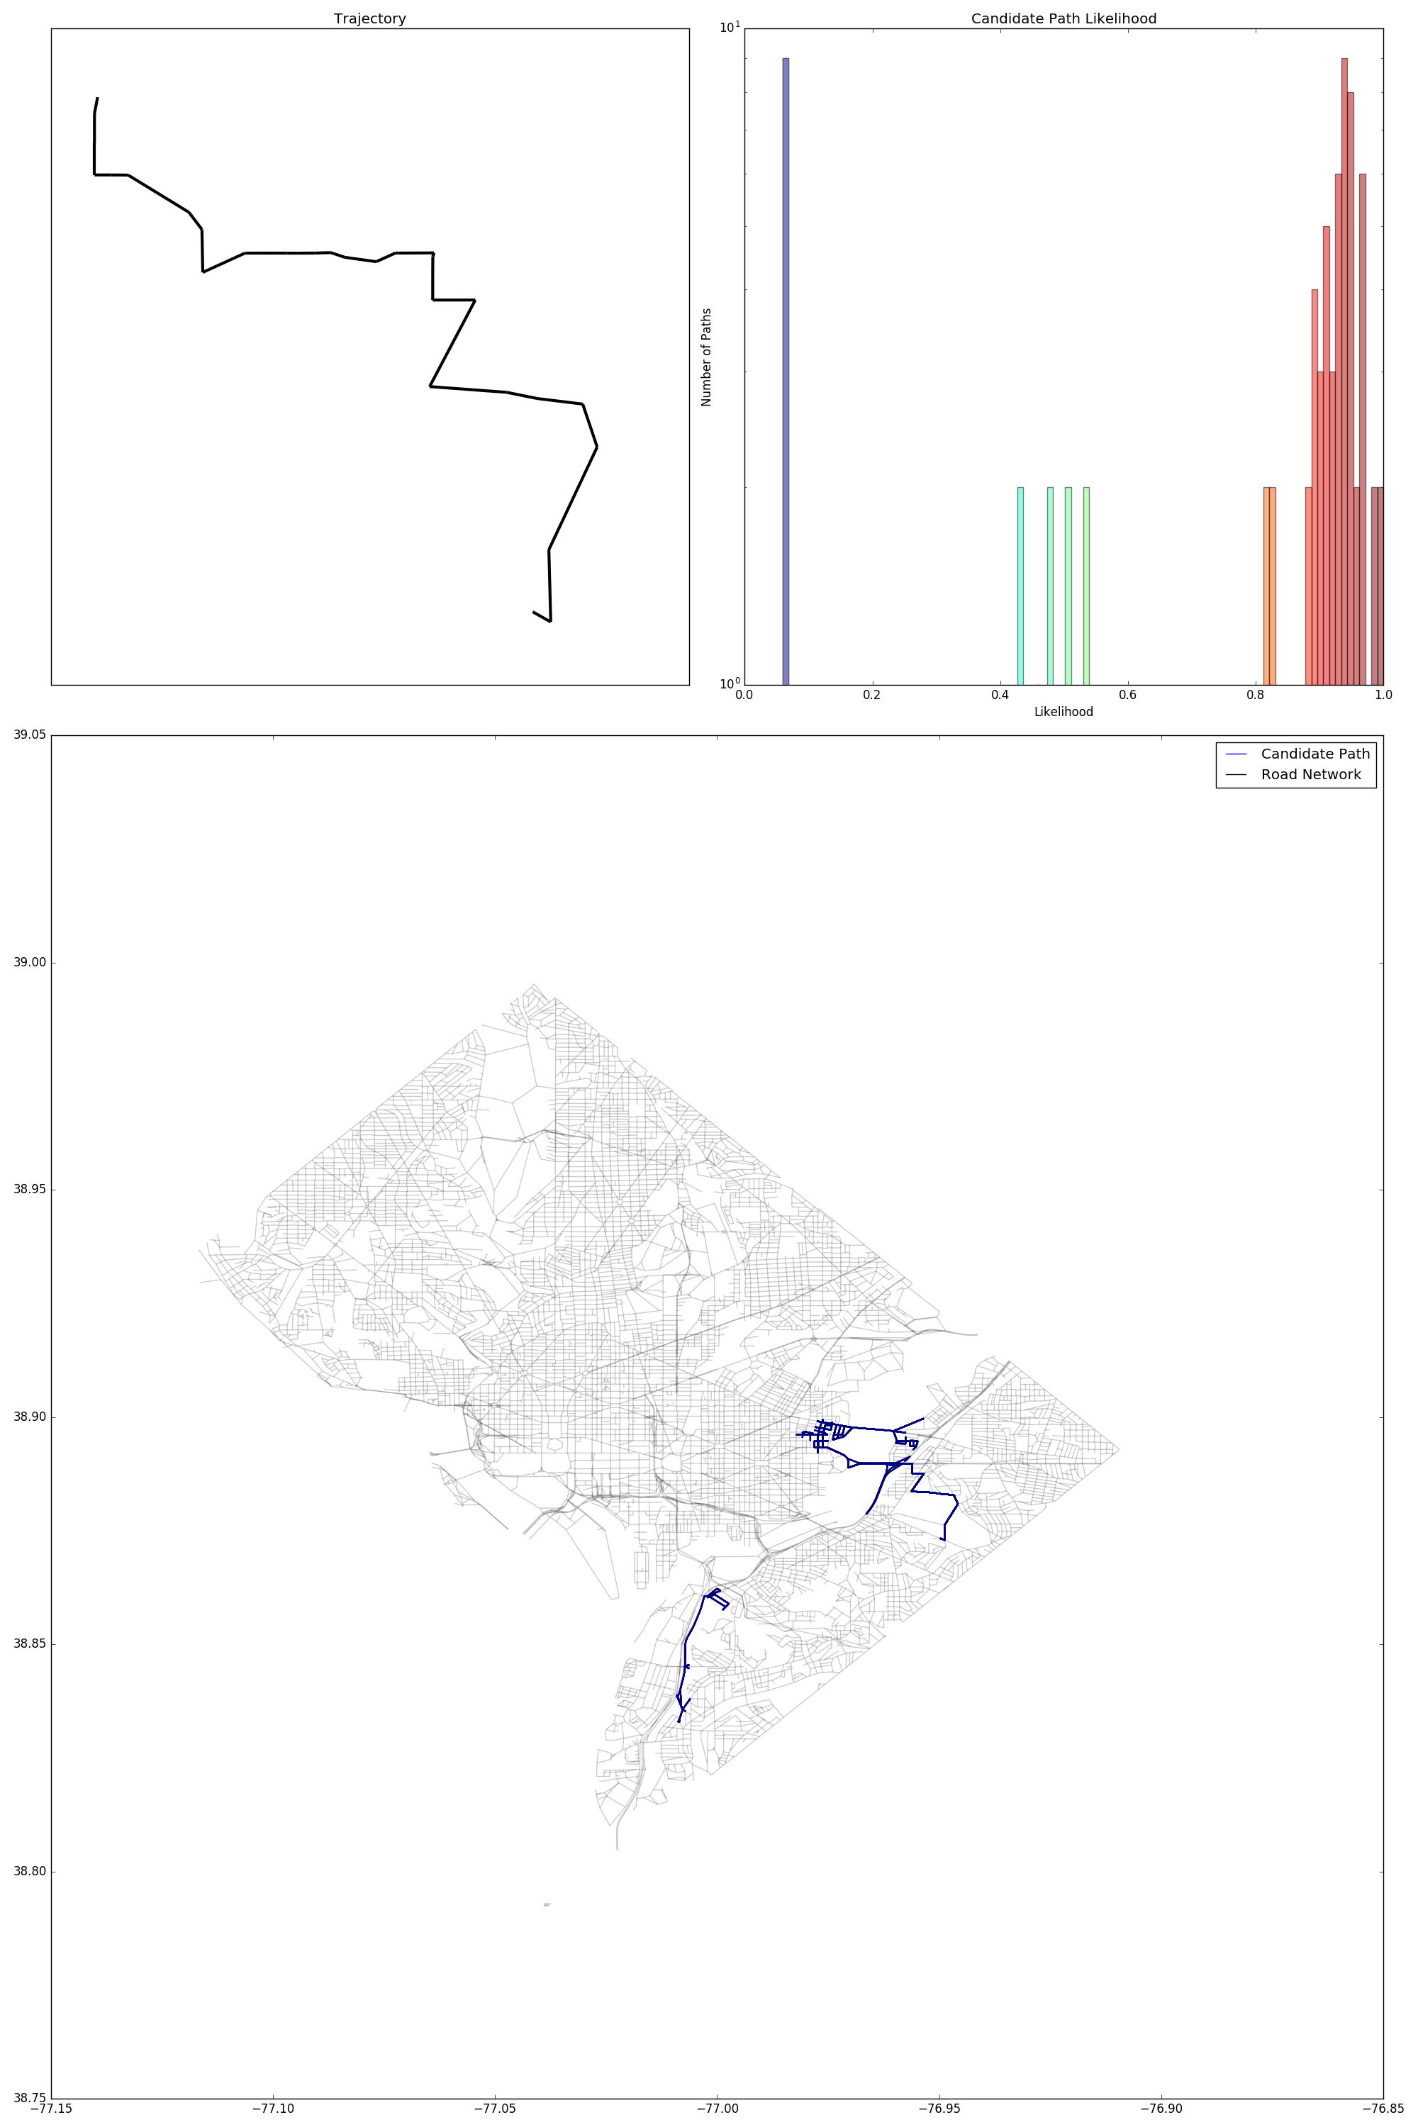
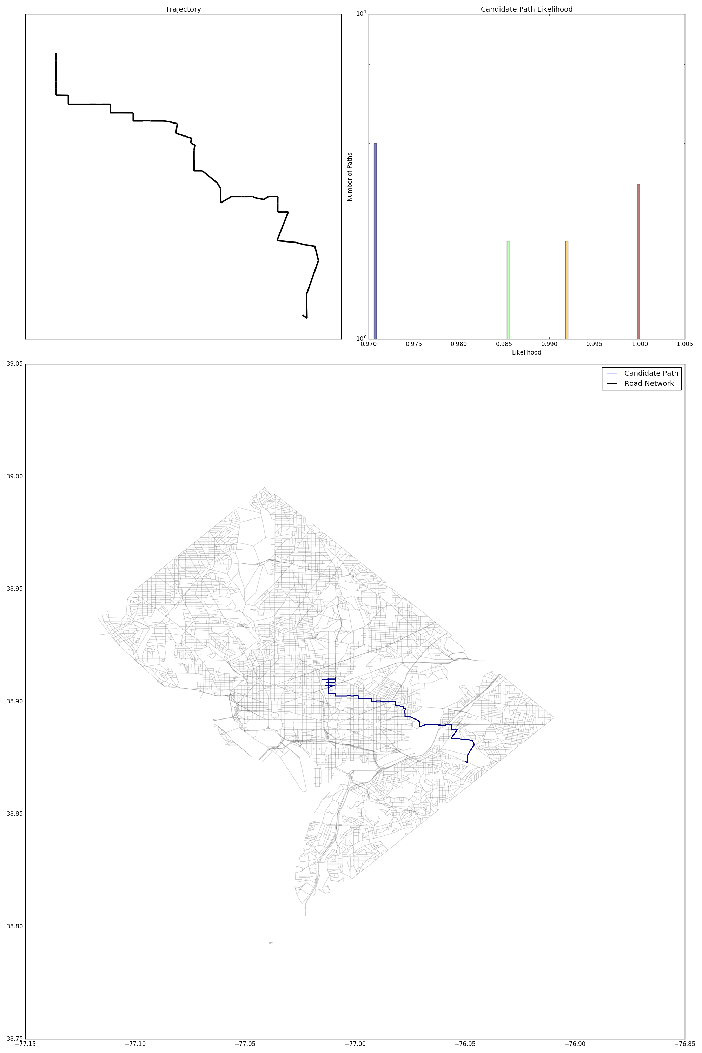
Key idea: Progressive Localization
Our probabilistic framework is designed to be robust to errors in both estimated trajectory and available map as we progressively find the actual traversal in map and thereby the Geolocation.

Slide 36
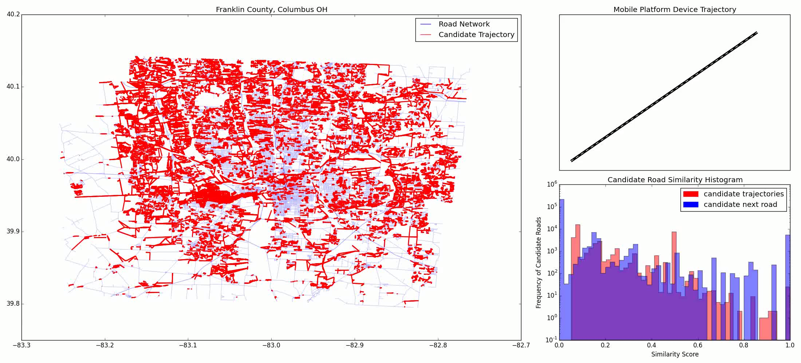
Trajectory Localization Columbus OH
Notes:
Demo Video of Matching Sample 1 from Columbus

Slide 37
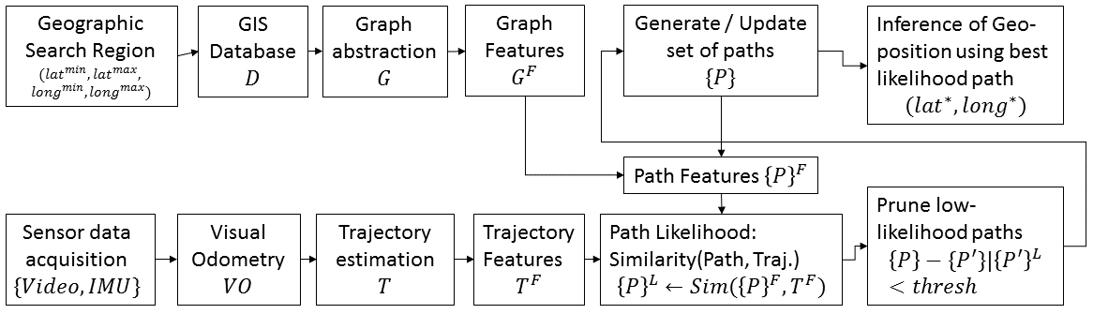
Approach
Comparing Trajectory & Traversal

Slide 38
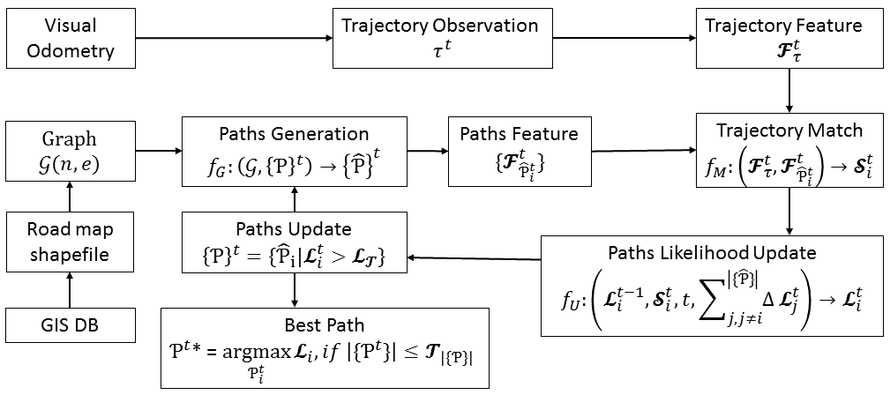
Approach
Spawning & Pruning matching traversals

Slide 39
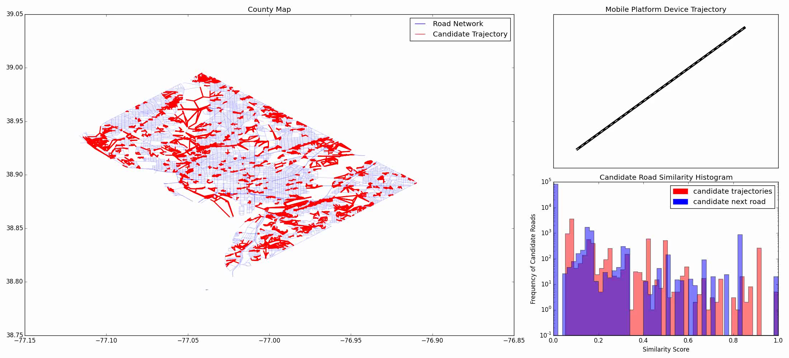
Trajectory Localization, Washington DC

Slide 40
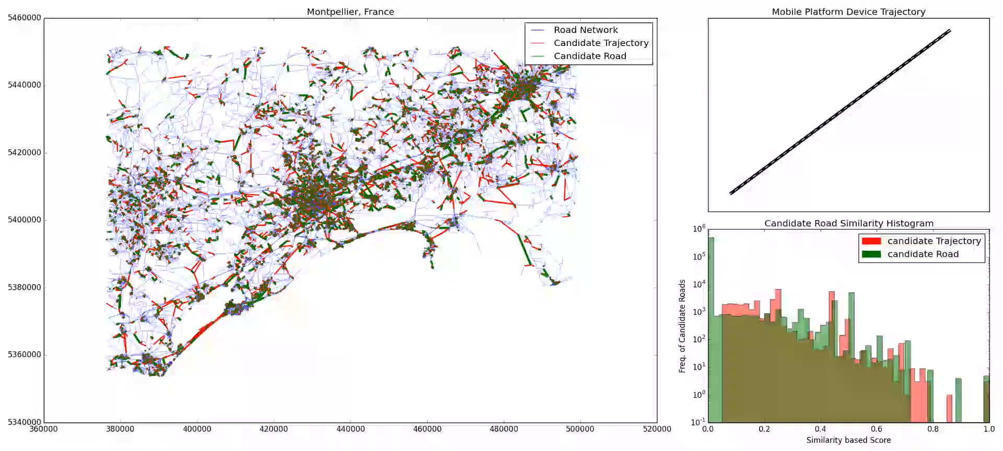
Progressive Positioning and Prediction
Map of Montpellier, France
Graph with 104K nodes and 137K edges
Urban and rural roads with fibrous structure

Slide 41


Indoor Localization
Indoor modeled using trafficable routes
Architectural elements, furniture, utility objects create different traffic routes.

Slide 42
Generate Shapefile from BIM
Indoor modeled using trafficable routes
Architectural elements, furniture, utility objects create different traffic routes shapefile.

Slide 43

Indoor Localization
Smith Lab 2nd floor, OSU
Modeled using 600 nodes and 350 edges

Slide 44

Ubiquitous Positioning

Slide 45
Future Work
Integrate GIS layers
Combine buildings, vegetation, terrain GIS layers with transportation layer for navigation.
Automated generation of traffic routes in the indoor environment.
Graph representation of multiple parallel paths: lanes on a road outdoors; navigable paths in a corridor indoors.

Slide 46




Trajectory in multiple GIS Layers
Elements of each GIS layer, in view of camera (sensor) are encoded to augment the trajectory.

Slide 47


Video frame classification
Visual object recognition will be used to classify GIS layer objects in camera view

Slide 48


Scale graph representation to multiple lanes

Slide 49

Questions…

